Slide 2
@queentaylorcos

Slide 3
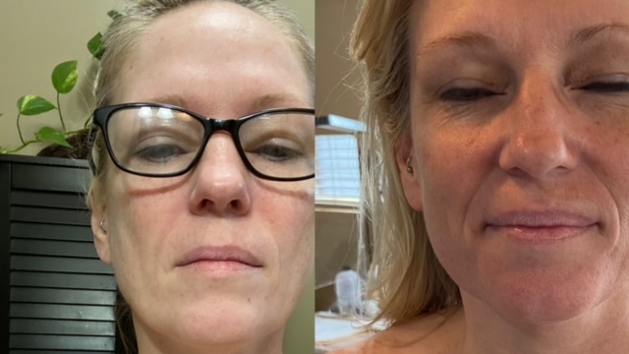

Slide 4
The Lady Is Using Copper Mist
Had been using for approximately
1 month 1-2 x a day
Has Vitiligo
Why it works: Copper is needed for every cell in the human body to make cells, hair, melanin...)
Copper mist is not for skin that is hyperpigmented it will make more pigment as you see here. If you are fighting hyperpigmentation use Antioxidant Gold Mist. Copper Mist is great to use on even skin for anti-aging.
Copper mist is producing pigment and filling in the vitiligo spots after just one month with pigment
Copper mist is stimulating the skin to make more pigment and the skin is getting darker.
Make sure the skin has vitiligo and not Tinea versicolor/sunspots- which is know as sunspots this is a fundus or a yeast that attacks the melanocyte cells if the client has this use Silver mist
Photo Credit by Brenda Gianangeli

Slide 5
--The man- is using Copper Mist
Feb 5 to March 11
He complained of being all white in his beard.
Not quite one 6 weeks using the Cooper Mist once a day
( Notice his skin hair color and eye color is darker too, this is because copper is needed for every cell in the human body to make cells, hair, melanin...) He is even starting to look younger just after a month- getting that twinkle in his eye, skin tightening and so on. This is because copper speeds up cell renewal. Copper is necessary in melanin production, so its making is skin tone darker as well as his eye color and hair. As for the grey hair there are tons of studies that support copper in reversing grey hairs.
Photo credit by Brenda Gianangeli

Slide 7
Before- Eczema- Client is seeing a Dermatologist
After- Using Balancing Silver Mist for 1 week
Photo Credit: Tiffany Bowen- Esthetician

Slide 10
Sometimes inexpensive and homemade products offer harsh ph.'s to the skin. A very good example: ZEST soap ZEST soap has a pH of 14 on the pH scale meaning it is 1 billion times more alkaline than the skin, the skin tries to return to its normal pH at or around 5 within 30 minutes of being taken outside of it. This over time is harmful to the skin. This is not the only client I see like this. I have at least 30 or 35 photos from products like these or when people make homemade products and don't balance the pH correctly.
The client in the photo below was using the product, the ordinary Mandelic peel and pre and post support products. The client contracted a contact type dermatitis. The solution: Discontinued product cool water washes to return the skin to its pH and rebalance the pH. I used the Calming & Soothing facial protocol- you will see this on our Qt Menu ( this is indirect high frequency and is the key to ridding the body of erythema/redness)
I used these key Queen Taylor products below with high frequency to resolve most of the redness from the skin.
Clarifying cleanser
Silver Mist
Balancing cleanser
Gold Mist
Royale Oil 400 MG CBD W/ Indirect High Frequency
Silver Mist
Detox Masque blended with silver mist
Gold Mist
Chocolate Antioxidant Masque
Silver Mist
Hydro-balance
Hydrate
Post Care: Balancing Cleanser, Silver Mist, Hydrate, Hydro-balance

Slide 13
Before – Psoriasis
After - Using Balancing Silver Mist
For 1-day
Photo Credit: Shonte Sanders- Esthetician

Slide 15
Brightening & Lightening
Multi-Acid Medi-Peel 1.0
1st photo was taken Feb 8th day of peel
2nd photo was Feb 23rd day 15 of peel
3rd photo was taken on March 9th day 31
She has no make up on, just lip gloss and magnetic lashes no foundation.
She is still using product.
Its important to continue to use once the peeling is complete.
Photo Credit: Queen Taylor Cosmeceuticals

Slide 17
Brightening & Lightening Multi-Acid Medical Peel 1.0 pH 3 Layers
Day 1 after Peel
Day 3 After Peel
Day 10 After Peel
Photo Credit: Queen Taylor Cosmeceuticals

Slide 21
Brightening & Lightening Multi-Acid Medical Peel 1.0 pH 5 Layers
Day 3 After Peel
Day 5 After Peel
Day 9 After Peel
Photo Credit: Queen Taylor Cosmeceuticals

Slide 25
Rejuvenate 25% TCA Medi Peel 1.0 pH 1 Layer
Photo # 1: Before Peel
Photo #2: Before Peel
Photo # 3: Under Woods Lamp photo
Photo # 4: Under Woods Lamp B & W photo
Photo # 5: Day 10 After Peel
Photo Credit: Queen Taylor Cosmeceuticals

Slide 30
Client has is moderately aged, with mostly skin laxity being signs of problematic aging.
Client received Brightening and Lightening multi-acid peel 2 layers to her face and neck. First photo is day 1. Second photo is two weeks later after peeling is complete.
Photo Credit: Queen Taylor Cosmeceuticals

Slide 32
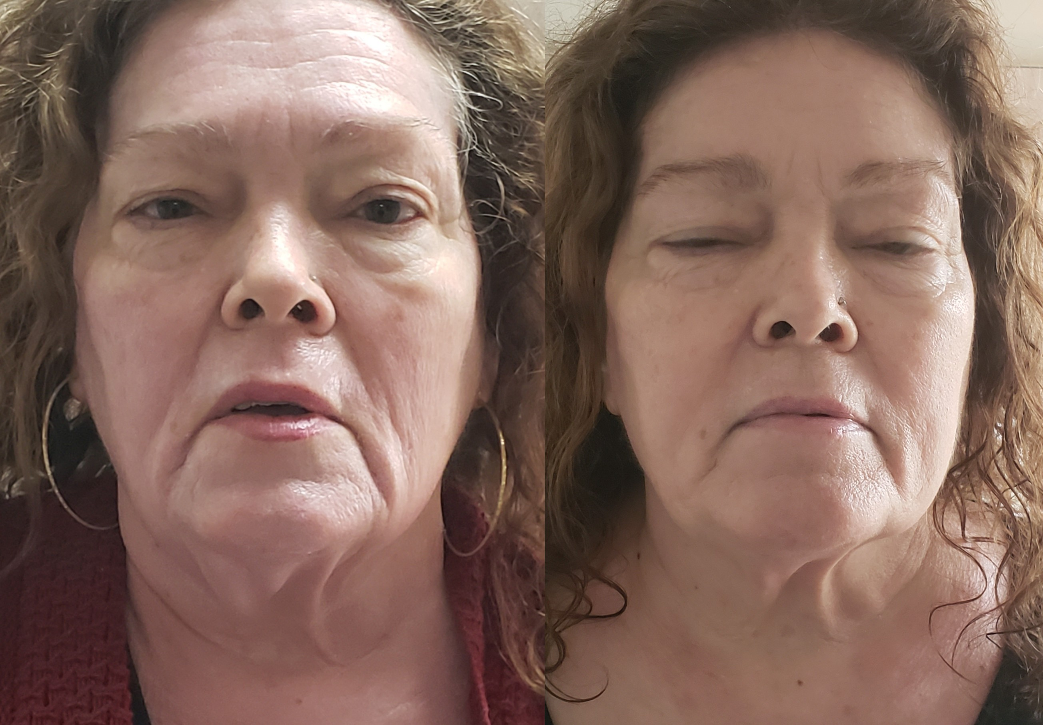
Day1 Day 14

Slide 33
Client has been using QT product line prior to Revive Peel
Photo #1: After 1st Revive Peel
Photo Credit: Sheryl Fluegeman

Slide 34
Client has PIH & PIE+ Post Inflammatory Hyperpigmentation, client started a sun block and tyronaise inhibitor regime two weeks prior to the peel. She received Queen Taylor Cosmeceuticals Brightening & Lightening Multi-Acid Peel. The first photo is Day 1 The 2nd photo is day 10 client received two coats and peeled for approx. 5-6 days Photo Credit- Queen Taylor Cosmeceuticals

Slide 36
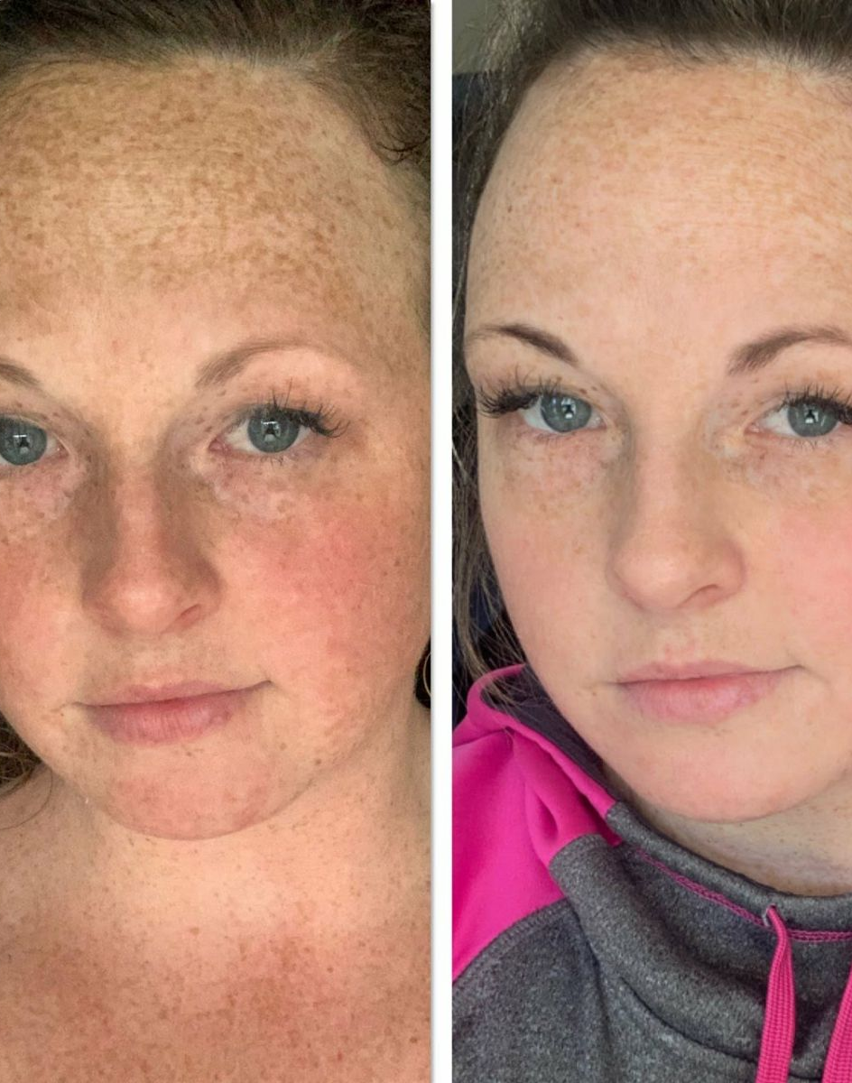

Slide 37
Brightening & Lightening Multi-Acid Medical Peel 1.0 pH 2 Layers
Day 1 after Peel
Day 15 After Peel
Photo Credit: Queen Taylor Cosmeceuticals

Slide 40
Revive Peel is our Esthetician Peel 30% Glycolic Acid @ 3.0 pH
Sold in a series of four weekly treatments.
Photo #2: Before, Third Revive Peel
Photo Credit: Sheryl Fluegeman

Slide 43
After Deep Cleansing

